Slide 1
CS 7320 Artificial Intelligence
Adversarial Search
(Games)

Slide 2
Overview

Slide 3
Overview
What is Adversarial Search
The Minimax Algorithm
Alpha-Beta Pruning
Alpha-GO

Slide 4
Adversarial Search

Slide 5
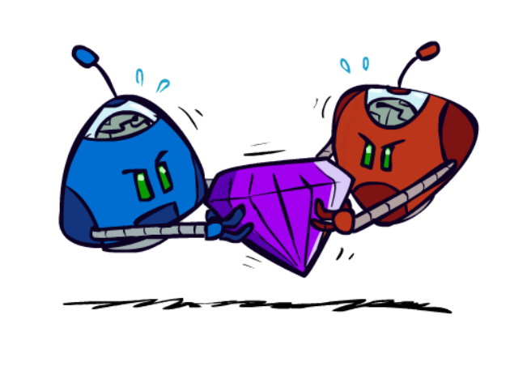
Adversarial search
More complex than search
"Unpredictable" opponent
Must specify a move for every possible opponent reply
Assume the opponent will make the best move for the opponent
For complex games such as checkers, chess, go → unlikely to absolute goal
Must approximate and set limit to search

Slide 6
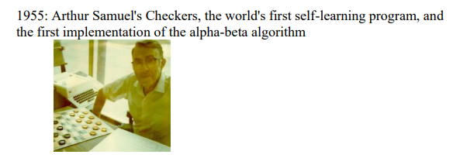
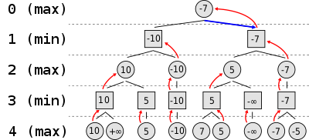
Arthur Samuel His program learned to play Checkers –using Minimax and alpha-beta algorithm

Slide 7
Minimax

Slide 8


Slide 9
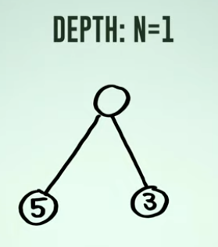
If we move left we get 5 and if we move right we get 3.
Move Left or Right?

Slide 11
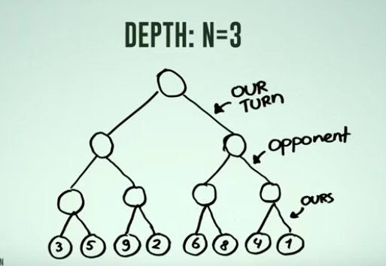
Challenge: Move Left or Right to get most points?

Slide 12
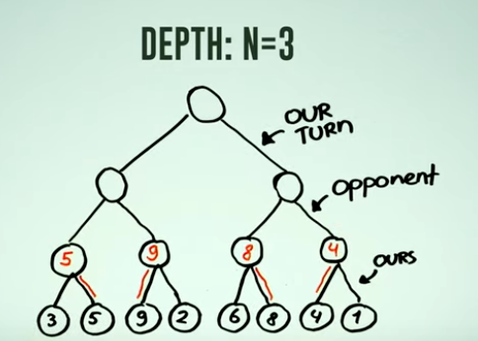

Slide 13
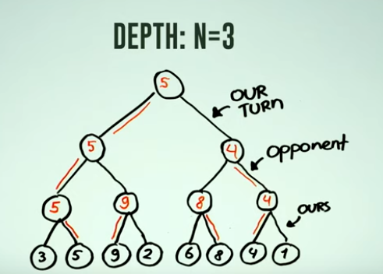

Slide 14
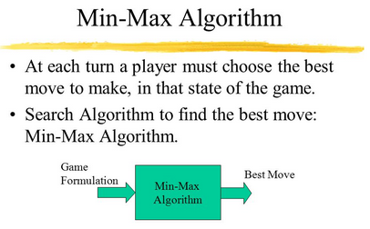

Slide 15
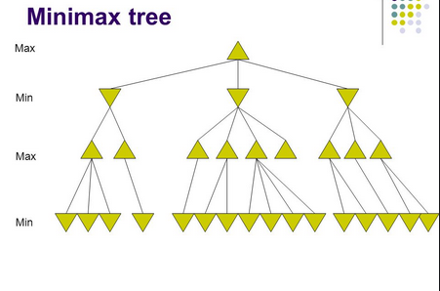

Slide 16
Properties of minimax
Complete? Yes (if tree is finite)
Optimal? Yes (against an optimal opponent)
Time complexity? O(b^{m})
Space complexity? O(bm) (depth-first exploration)
For chess, b ≈ 35, m ≈100 for "reasonable" games → exact solution completely infeasible

Slide 17
Game Trees

Slide 18
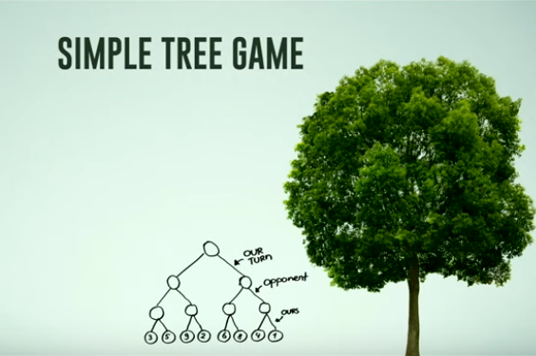
Branching factor =2
Game Depth = 3
Perfect Information

Slide 19
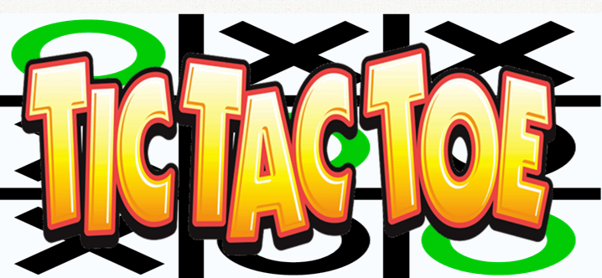
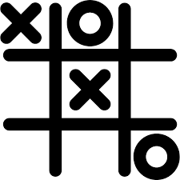

Slide 20
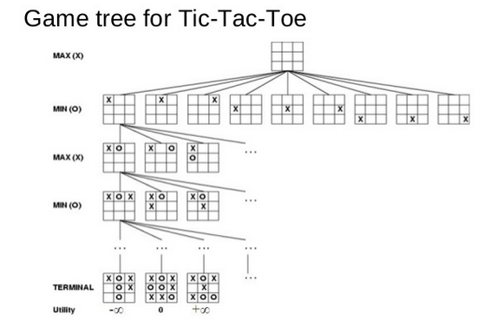
How to evaluate nodes?
-1 0 1

Slide 21
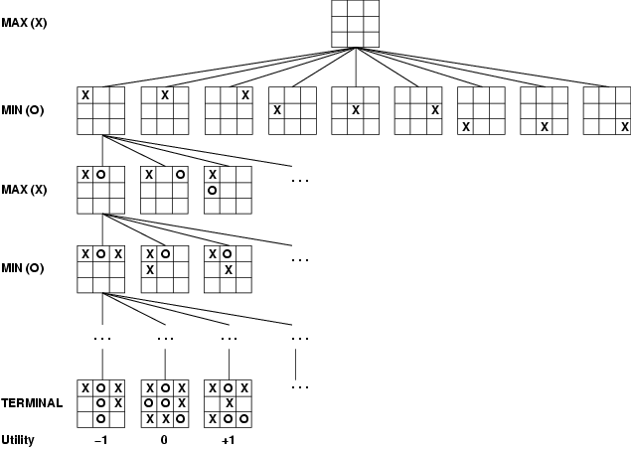
Game tree (2-player, deterministic, turns)
Evaluation/ Utility Function
1 = X wins
-1 = Y wins
0 = no win yet

Slide 22
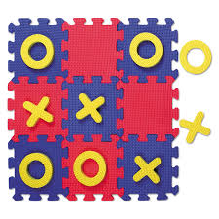
Tic Tac Toe
Branching Factor: 5 (9+8+7+6+5+4+3+2+1)/9
Depth: Max 9 moves
Removing symmetries there are 138 terminal positions
X wins 91 times
O wins 44 times
draw: 3 times
If both players play according to minimax the game will always end in a TIE

Slide 23
MiniMax Algorithm

Slide 24
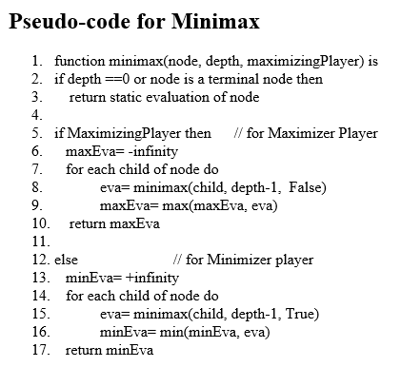
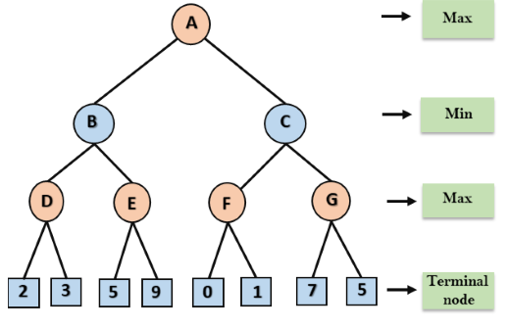
Minimax Example

Slide 25
Minimax Example
3
9

Slide 26
Minimax Example
3
3
9

Slide 27
Minimax Example
3
3
3
9

Slide 28
Minimax Example
3
3
3
9
1
7

Slide 29
Minimax Example
3
3
1
3
9
1
7

Slide 30
Minimax Example
3
3
1
3
9
1
7

Slide 31
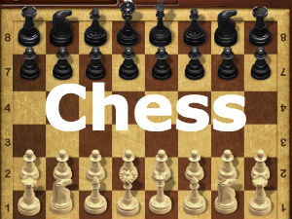

Slide 32
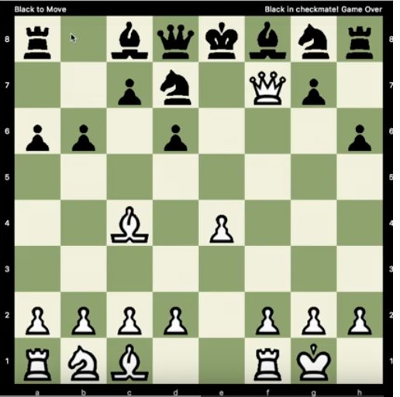
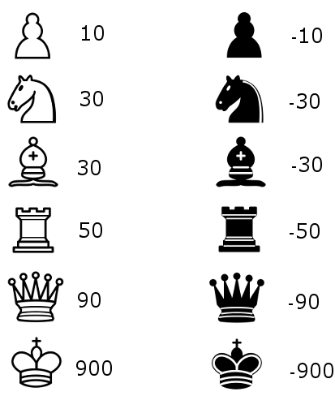
Chess is More Complex

Slide 33
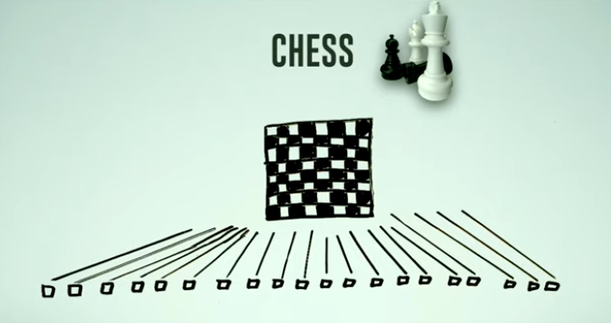

Slide 34
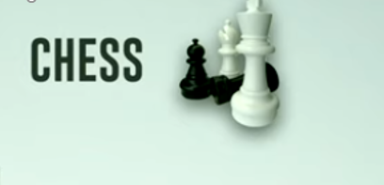
No perfect information
We can't evaluate until the final node
How do we evaluate a node
Count the pieces?
Evaluate piece positions?
Many options exist and form the basis of competing chess engines (e.g. Stockfish)

Slide 35
The Horizon Problem

Slide 36

The Horizon Problem
The computer cannot see beyond the lowest node it evaluates

Slide 37
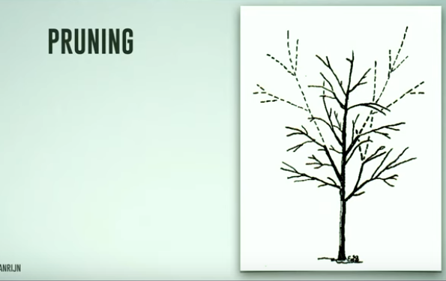
To deal with games trees that go "beyond the horizon" we can try and prune the tree – eliminate nodes to search.
Alpha-Beta Pruning
- A technique for reducing Minimax search by eliminating some nodes in the search tree
- Developed by Arthur Samuel (1958) to improve performance of his Checkers Program

Slide 38
To deal with games trees that go "beyond the horizon" we can try and prune the tree – eliminate nodes to search.
Two kinds of Pruning
forward pruning - risky
backward pruning - (alpha-beta pruning) is safer

Slide 39
Forward Pruning
If a move is too bad : stop evaluating
move my Queen to middle of the board
If a move is too good : stop evaluating
opponent moves their Queen to the middle of the board for easy capture
risky? Horizon problem

Slide 40
Alpha-Beta Pruning

Slide 41
Alpha-Beta Pruning
A technique for reducing Minimax search by eliminating some nodes in the search tree
Developed by Arthur Samuel (1958) to improve performance of his Checkers Program

Slide 42
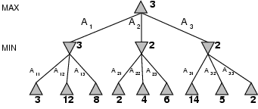
Minimax
Perfect play for deterministic games
Idea: choose move to position with highest minimax value = best achievable payoff against best play

Slide 43

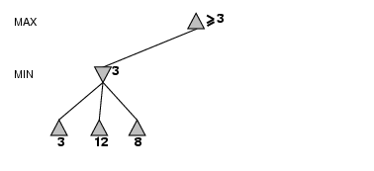
α-β Pruning Example
Algorithm:
Init: alpha = -inf
beta = +inf
Prune Tree when beta <= alpha

Slide 44
α-β Pruning Example
Algorithm:
Init: alpha = -inf
beta = +inf

Slide 45
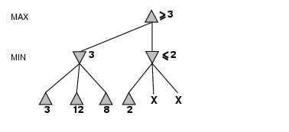
α-β Pruning Example (cont’d)
We know MIN will get 2 or LESS from this branch – BUT since MAX knows he can get at least 3 he will never pick this branch, why bother?
MIN can Quit when beta <= alpha

Slide 46
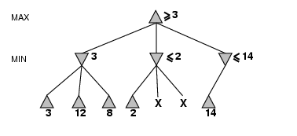
α-β Pruning Example (cont’d)
MIN hopes that he can find a value less than 14, so he must continue to evaluate

Slide 47
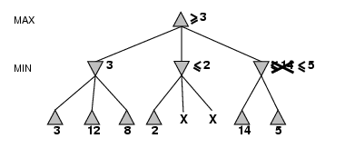
α-β Pruning Example (cont’d)
MIN will pick 5 BUT hopes he can do even better

Slide 48
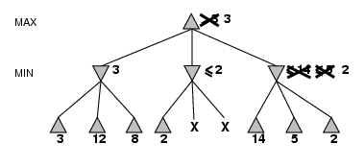
α-β Pruning Example (cont’d)
MAX will get 3 if he goes left

Slide 49
Alpha-Beta Pruning A More Detailed Example

Slide 50
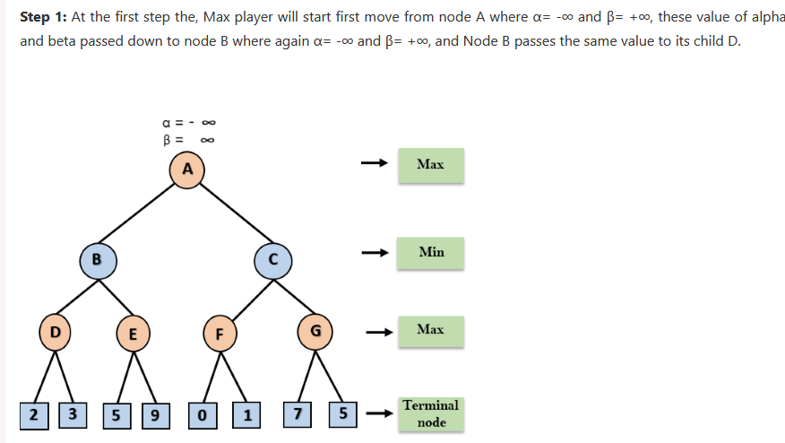
Step1

Slide 51
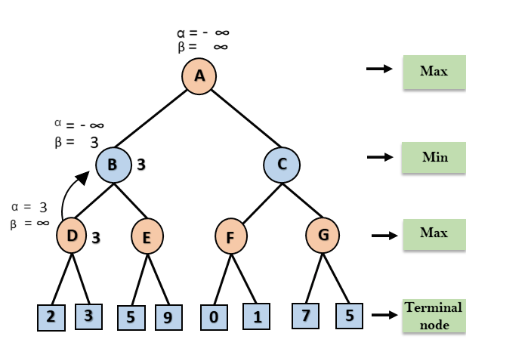
Step 2

Slide 52
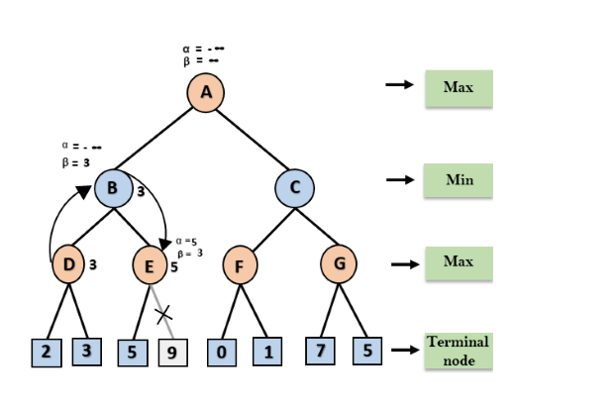
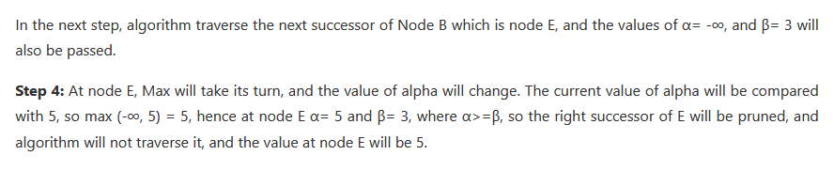
Step 4

Slide 53
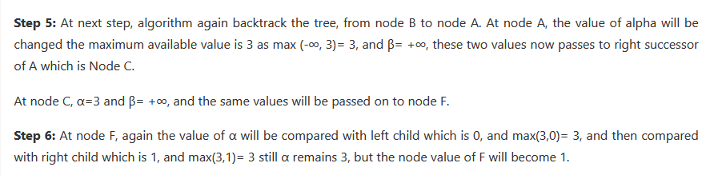
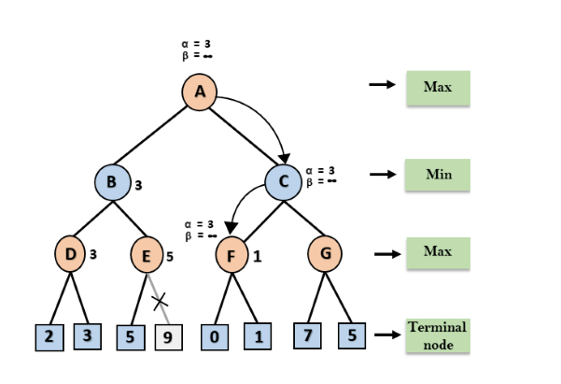
Step 6

Slide 54
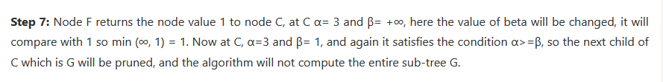
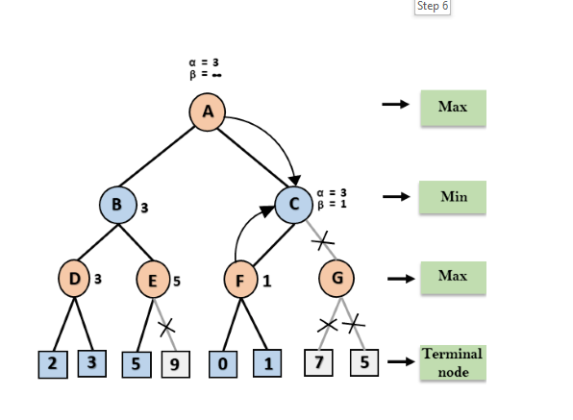
Step 7

Slide 55

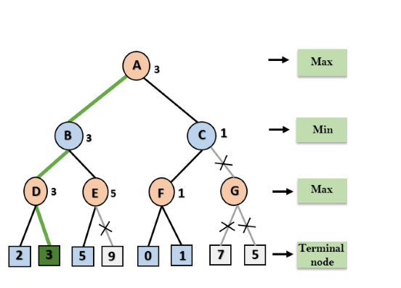
8

Slide 56
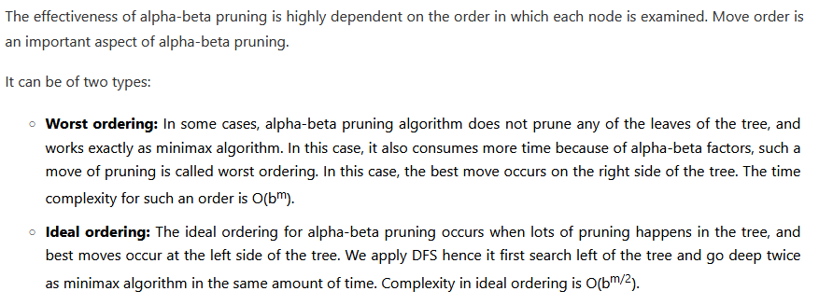
Move Ordering in Alpha-Beta

Slide 57
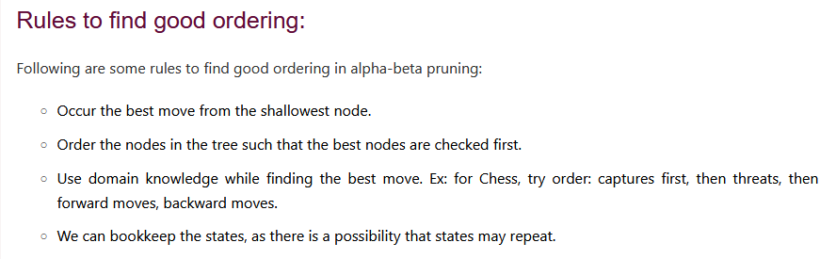
Good Ordering

Slide 58
More detailed example article:
https://www.javatpoint.com/ai-alpha-beta-pruning

Slide 59
Alpha-Beta Pruning Algorithm (warning: Recursion Ahead!)

Slide 60
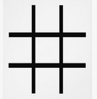
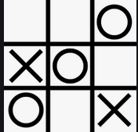
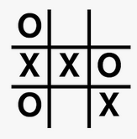
Tic Tac Toe
Game Board Implementation (string)
'---------' empty board
--OXO-O-X'
'O--XXOO-X'

Slide 61
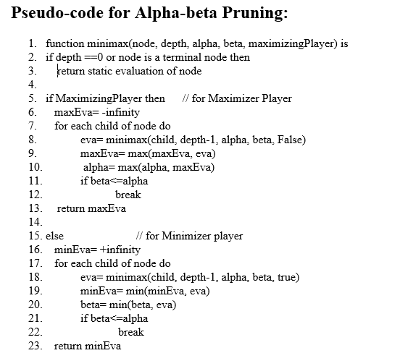
minimax('---------', 9, -inf, +inf, True)
First child of the empty board
minimax('X--------', 8, -inf, +inf, False)

Slide 62
minimax('X--------', 8, -inf, +inf, False)
minimax('XO-------', 7, -inf, +inf, True)
Let's call minimax until we get a winning board →

Slide 63
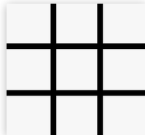
X O X
O X O
evaluates to 1
X
minimax('XOXOXOX--',2, -inf, +inf, False)
Return 1 : for X wins
minimax('XOXOXO---', 3, -inf, +inf, True)
eva = 1
maxEva = 1
alpha = 1
if (+inf <= 1) break

Slide 64
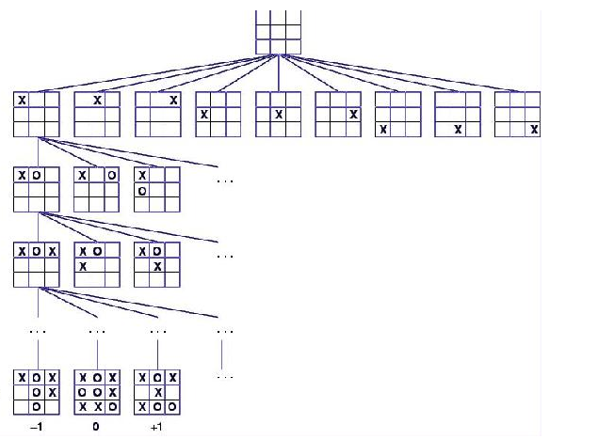
Game Tree

Slide 65
StockFish Alpha-Beta Pruning Plus Heuristics

Slide 67
Recent Advances in Adversarial Search and Games

Slide 68
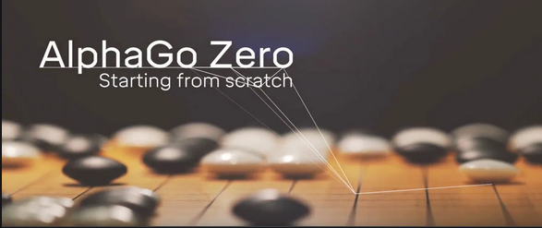
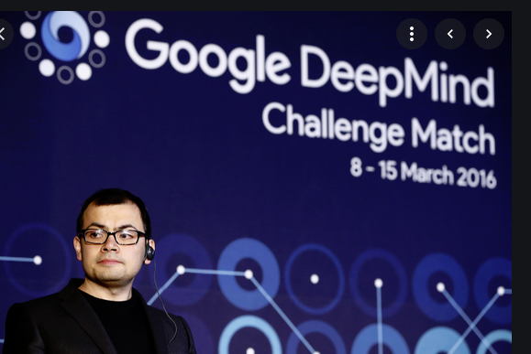
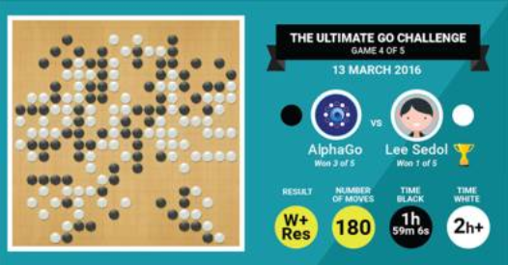
Alpha GO Zero

Slide 69
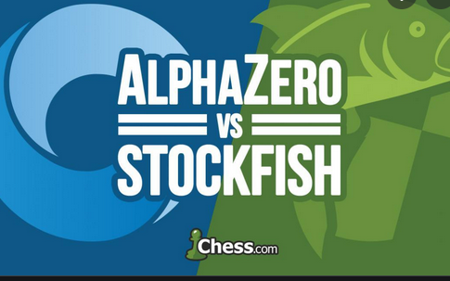
AlphaZero Defeats Stockfish

Slide 70
Summary

Slide 71
Summary
Minimax is used to select the optimal move for 2-person games
Max tries to maximize their position
Min tries to minimize the position
Game trees can be very computationally intensive when users have many move choices (as in chess)
Arthur Samuel in the 1950s developed the alpha-beta algorithm to prune branches of a game tree based on knowledge obtained during the game tree search
Reinforcement Learning has led to a breakthrough in game play for GO and Chess with the Alpha-GO program developed by Google
See the video : https://www.youtube.com/watch?v=PUaCQUal7rM

